Slide 1
Configuration Management

Slide 2
Configuration Management
Includes four varieties of change
Version control
System building
Release management (chapter 12)
Change management (chapter 9)

Slide 3
Version Control

Slide 4
What is version control?
Management of changes to a document over time
Often refers to source code
Revision 1, revision 2, etc.
Team work increases the complexity of version control
Why?

Slide 5
Repository
Centralized data store
Holds the authoritative source documents
Tracks historical versions
Usually client/server
A number of clients connect to the repository to read/write files
May be distributed
Repository
Write
Read
Read
Client
Client
Client

Slide 6
Working Copy
A local copy of a particular version that a user can modify
Local directory is unaware of the versioning
VCS handles updates to the repository

Slide 7
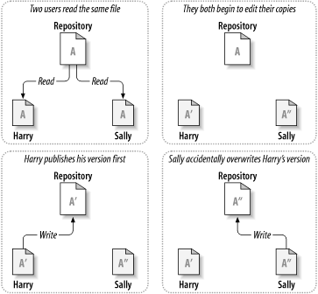
Problems with file sharing

Slide 8
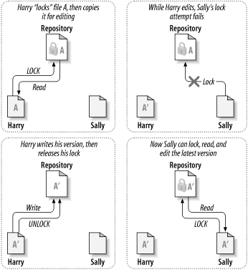
Lock-Modify-Unlock
Problems:
Forget to unlock
Excess serialization
File level locking can result in incompatible files

Slide 9
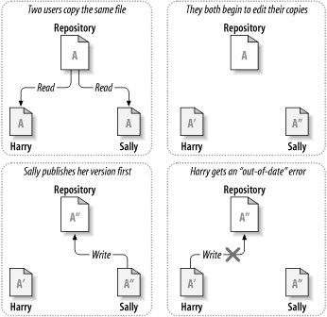
Copy-Modify-Merge

Slide 10
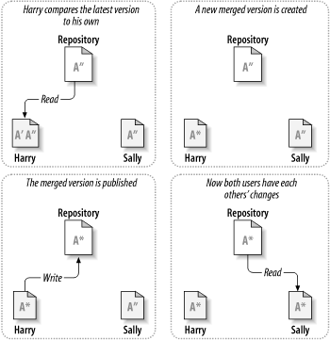
Copy-Modify-Merge

Slide 11
Version Control Systems
Notes:
Start here

Slide 12
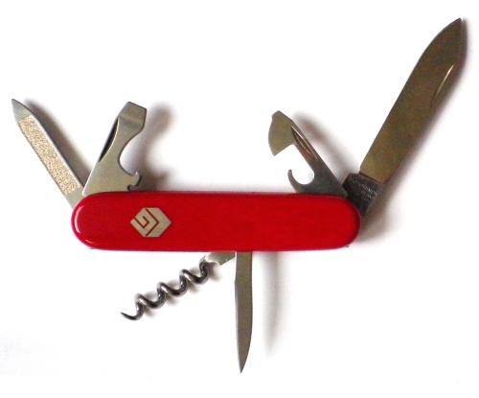


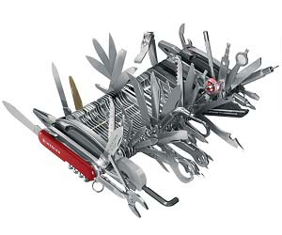
40 Years of Version Control
© 2012 David Patterson & David Patterson
Licensed under Creative Commons Attribution-NonCommercial-ShareAlike 3.0 Unported License
SCCS & RCS (1970s)
CVS (1986)
Subversion (2001)
Git (2005)
Image © TheSun.au

Slide 13
History
RCS (Revision Control System)
Automates the storing, retrieval, logging, identification, and merging of revisions
Each file contains additional information to track changes
CVS (Concurrent Version System)
Extends RCS
Client/server
Allows concurrent modification
Open source

Slide 14
Subversion (SVN)
Written as a replacement for CVS
Improvements
Ability to rename and move files without losing history
Supports atomic commits
Supports branching
More robust repository format
Subversion is installed on our Front server
Subversion features: http://subversion.apache.org/features.html

Slide 15
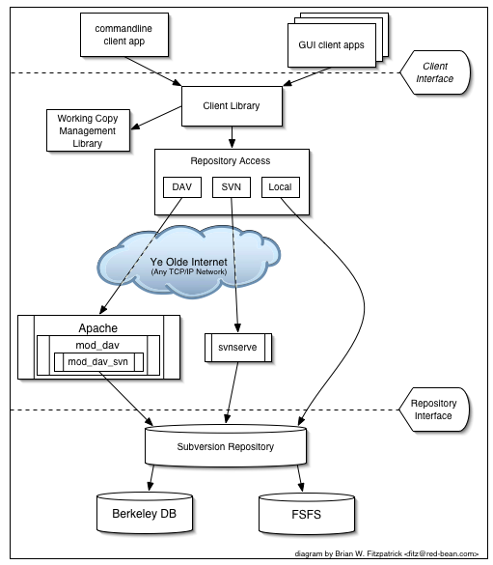
Subversion Architecture

Slide 16
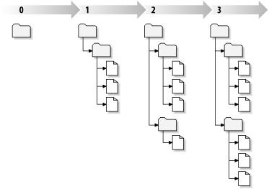
Revisions
A Subversion client commits all changes as a single atomic transaction
Each time the repository accepts a commit a new revision is created
Revisions are numbered starting a zero
Global revision number – applies to all files
File system tree over time

Slide 17
Repository Directory Structure
Head
Mainline of development
Trunk
Branch
Divergent copies of development line
Tag
Stable snapshot of a particular development line

Slide 18
Distributed Version Control

Slide 19
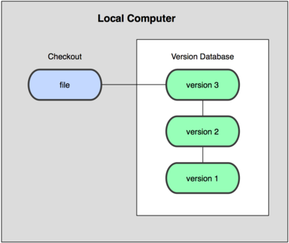
Local Version Control Systems

Slide 20

Centralized Version Control Systems

Slide 21
Problems with Centralized VC
Single point of failure
Limited access when not online

Slide 22
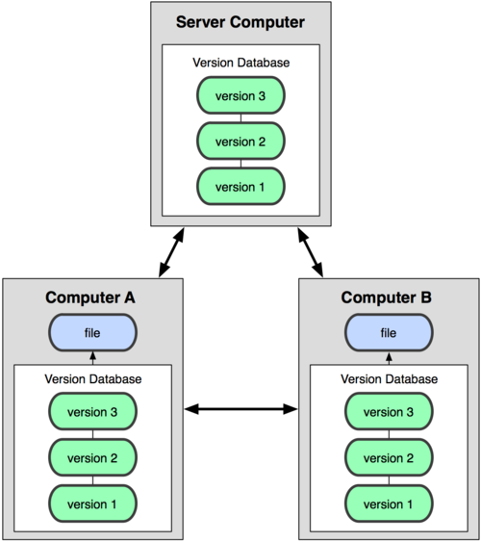
Distributed Version Control Systems
Don't check out just the latest snapshot of the files
Fully mirror the repository

Slide 23
Git

Slide 24
History
Developed to manage versions of Linux
Goals of new system
Speed
Simple
Strong support for non-linear development
Fully distributed
Able to handle large projects

Slide 25
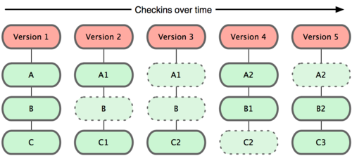
Git Data

Slide 26
Git Basics
Nearly every operation is local
Has integrity
Only adds data (generally)

Slide 27
Git States
Three main states that your files can be in
Committed
Modified
Staged

Slide 28

Local Operations

Slide 29
Git Workflow
Modify files in your working directory
Stage files
adds snapshots of files to your staging area
Commit
Takes files in staging area and stores snapshot permanently
Push
To a repository

Slide 30
Using a Git Repository
Two approaches
Take an existing project and import it into Git
Clone an existing Git repository from another server

Slide 31
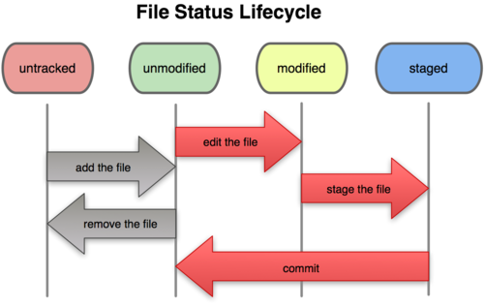
Recording changes

Slide 32
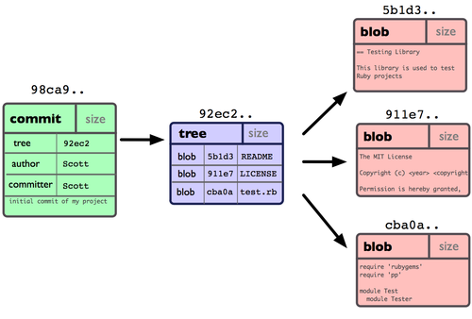
Git Data Storage

Slide 33
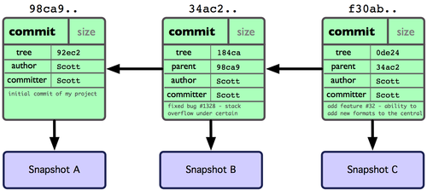
Repository after several commits

Slide 34
Using Branches Effectively
Engineering Software as a Service§10.5

Slide 35
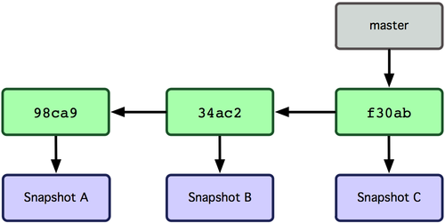
Git Branch
Lightweight pointer to a commit
Default name is Master
Every time you commit it moves forward
Notes:
start here

Slide 36
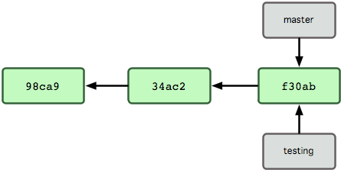
Creating a new branch
Use the branch command git branch [branch-name]
Creates a new pointer to the current commit
This pointer will move separately from other pointers

Slide 37
Head pointer
The head pointer is a pointer to the branch that you are currently working on
To switch to a different existing branch use checkout git checkout [branch-name]

Slide 38
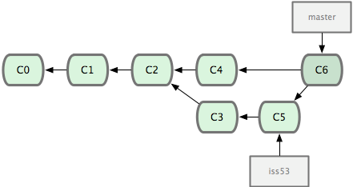
Basic Merge
Git finds the best common ancestor and creates a new commit object with the merged work

Slide 39
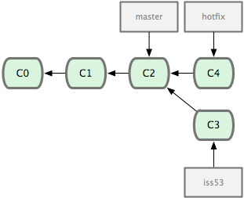
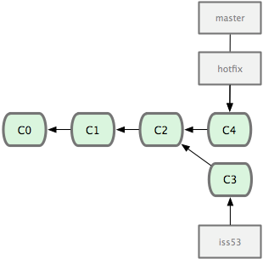
Merging – Fast Forward Merge
Before Merge
After Merge

Slide 40
Creating new features without disrupting working code
To work on a new feature, create new branch just for that feature
many features can be in progress at same time
Use branch only for changes needed for this feature, then merge into master
Back out this feature ⬄ undo this merge
In well-factored app, one feature shouldn't touch many parts of app
Notes:
Worse if long time; branches shouldn't be long-lived in agile development

Slide 41
Mechanics
Create new branch & switch to it
git branch CoolNewFeature
git checkout CoolNewFeature ⬅current branch
Edit, add, make commits, etc. on branch
Push branch to origin repo (optional):
git push origin CoolNewFeature
creates tracking branch on remote repo
Switch back to master, and merge:
git checkout master
git merge CoolNewFeature ⬅ warning!!

Slide 42
Mechanics
Create new branch & switch to it git branch CoolNewFeature git checkout CoolNewFeature ⬅current branch
Edit, add, make commits, etc. on branch
Push branch to origin repo (optional) git push origin CoolNewFeature
creates tracking branch on remote repo
Switch back to master, and merge git checkout master git merge CoolNewFeature ⬅ warning!!

